Slide 1

Magic Pie
(mgcpy)
Team Captain: Sambit Panda
Sandhya Ramachandran, Bear Xiong, Richard Guo, Satish Palaniappan, Ananya Swaminathan
Date: 9/12/2018

Slide 2
Sprint 1: Create mgcpy package
Task 1: Implement HHG, Pearson/RV/Cca, and Spearman/Kendall into package (Sambit)
Task 2: Implement MGC into the package (Satish)
Task 3: Implement MDMR and FastMGC into package (Sandhya)
Task 4: Implement MCORR, DCORR, and Mantel into package (Bear)
Task 5: Implement Random Forest independence tests into package (Richard)
Task 6: Implement 2- sample tests into package (Ananya)

Slide 3
Determine whether a single connectome has linear correlations that can be visualized
Patient: sub-NDARAA536PTU_acq-64dir_dwi_JHU_res-1x1x1_measure-spatial-ds.edgelist
Produced correlation map of part of the edgelist file
Calculated distance correction of the correlation matrix
Calculated pearson’s correlation between 2x2 row-wise adjacent blocks of the correlation matrix

Slide 4
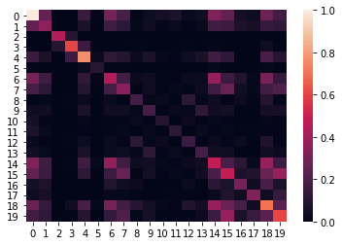
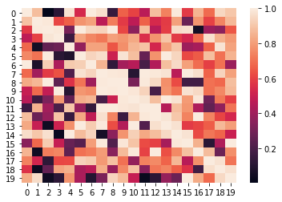
Visualization
Normalized Correlation Matrix of Edgelist File
Pearson’s Correlation Between Diagonal Elements

Slide 5
Task 1 (Sambit): Implement HHG, Pearson/RV/Cca, and Spearman/Kendall into package
Last Week’s Accomplishments:
Merge simulations into development branch
Begin creating other simulations mentioned in paper
Change rv_corr from function to class
Fixed Bernoulli simulation

Slide 6
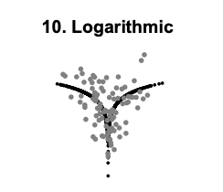
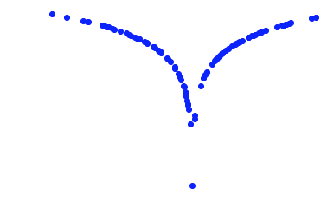
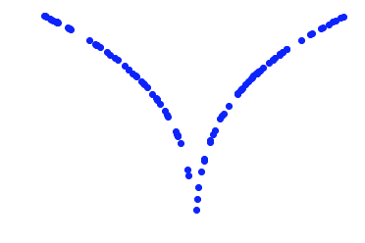
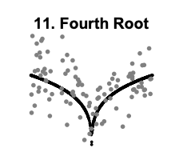
Simulation plots
Calculated Y array
Calculated X array (100 samples, 1 dimension, 0 noise)
Logarithmic Simulation
4th Root Simulation

Slide 7
Stuff to do this week
Finish the rest of the simulations in the paper
DoD: Plots of the simulations
Begin creating HHG class
DoD: Class uploaded to Github

Slide 8
Task 2 (Satish): Implement MGC into the package
Last Week Accomplishments:
Implement MGCSampleStat module with the Thresholding, Smoothing, and mgc.sample (MGC measure computation) functions from R in Python, with tests and merge PR
Refactor mgc to extend and implement the IndependenceTest abstract class and merge PR

Slide 9
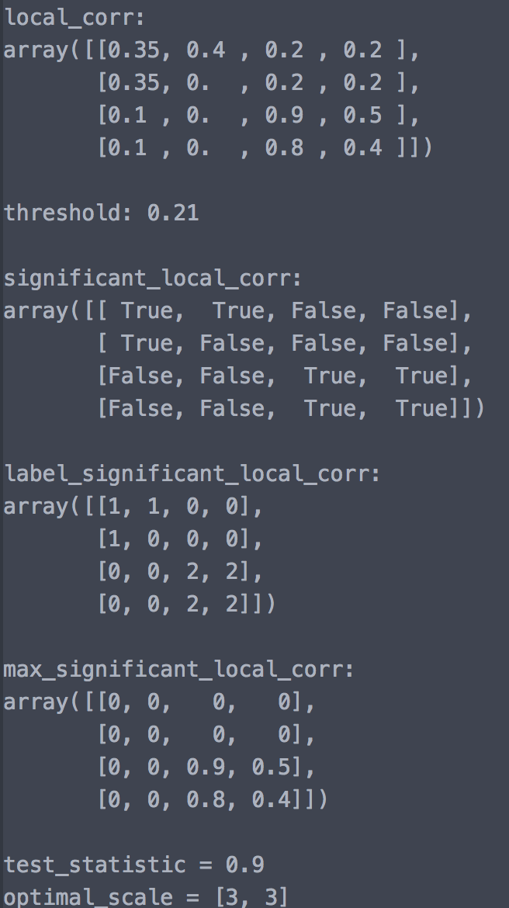
Pseudocode for MGC Test Statistic Computation
[test_stat, optimal_scale] = mgc_sample(X,Y)
Inputs: X and Y are [n*d] data matrices
Outputs: mgc test statistic and optimal scale
Algorithm
Step 1: Compute all local correlations
Step 2: Thresholding
Compute parametric and non-parametric threshold using beta approx. and data adaptive methods
Take max of both as the threshold
Threshold the local correlation matrix
Find the largest connected component of significant correlations
Step 3: Smoothing
Default test statistic at maximal scale
If connected region's area is sufficiently large
find the scale within the significant connected region that maximizes the local correlation
Return test statistic and optimal scale

Slide 10
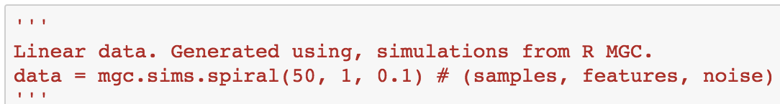
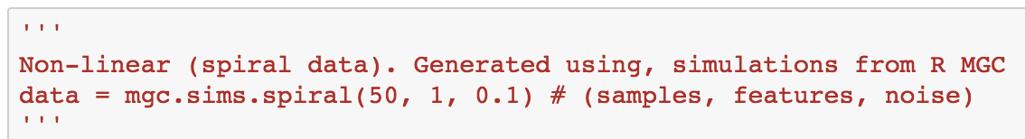
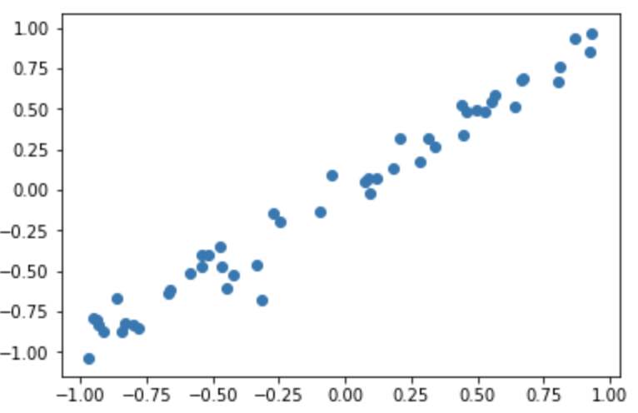
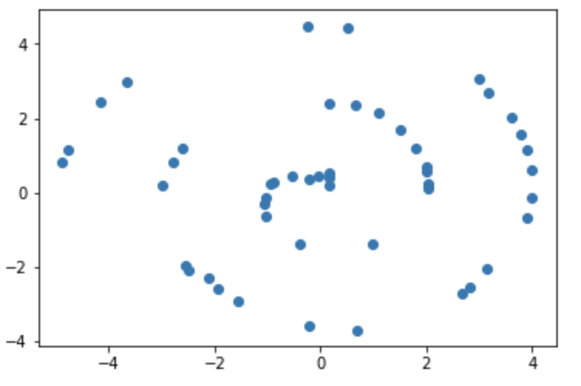
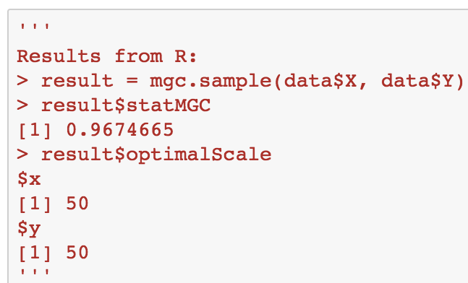
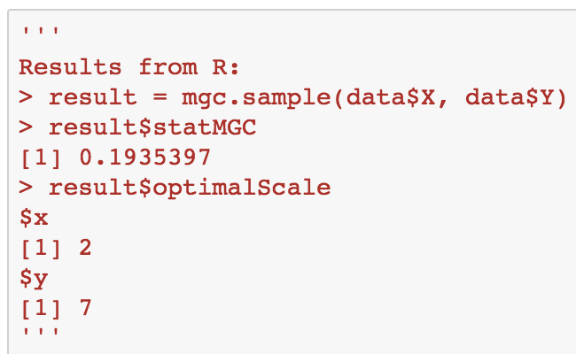
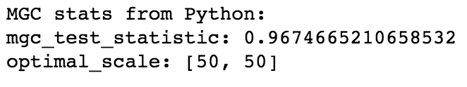
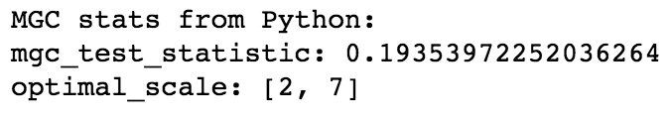
Comparison with results from R (notebook)

Slide 11
Stuff to do this week
Extract Bear’s permutation test from DCorr into a common utility and use that to compute p-value in MGC.
Run Python MGC on higher dimensional data and report the performance and accuracy, comparing to the R version.
Write a master function in main.py that can call the different independence tests.

Slide 12
Task 3 (Sandhya): Implement MDMR and FastMGC into package
Last Week’s Accomplishments:
Rewrite code to automatically test all columns of X data: load data and run, functions
Contact author again, ask about testing multiple columns at a time

Slide 13
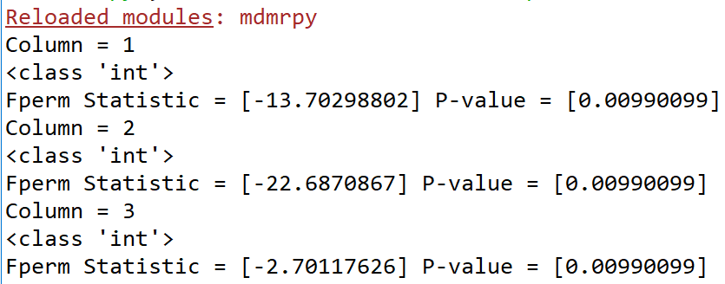
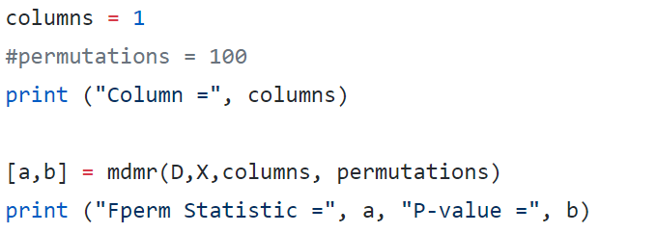
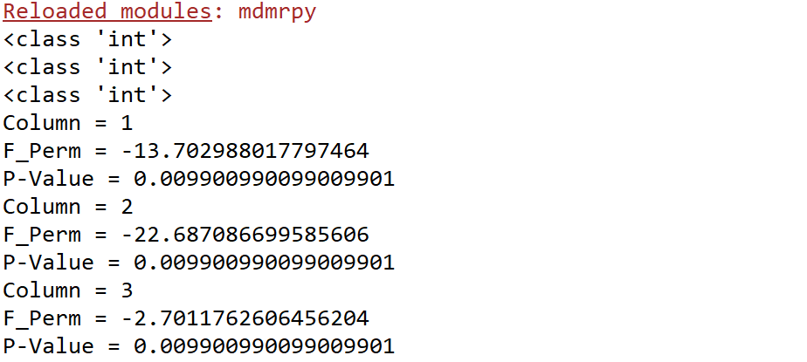
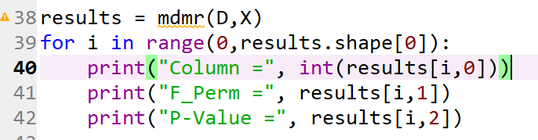
3X
---------------------------------------VS-----------------------------------------
Notes:
Previously

Slide 14
Next Week:
Read MDMR paper on analytic p-values: paper
Make changes to code for columns input as author (Anibal) suggests
Reach: Write pseudocode or code for analytic p-values
Discuss incorporation of finished MDMR code (with permutation p-values) with team members more experienced with github

Slide 15
Task 4: Implement mcorr, dcorr, mantel (Bear)
Last Week
Compute power
DoD: verify results against matlab code CorrIndTestDim.m
Permutation test for p-value of dcorr, mantel
DoD: verify results against matlab code DCorPermutationTest.m

Slide 16
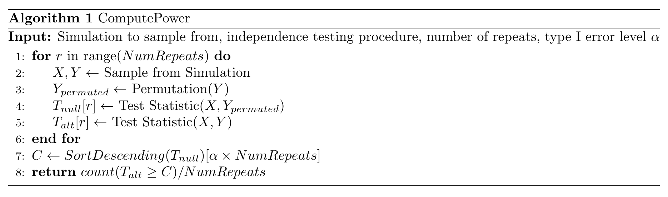
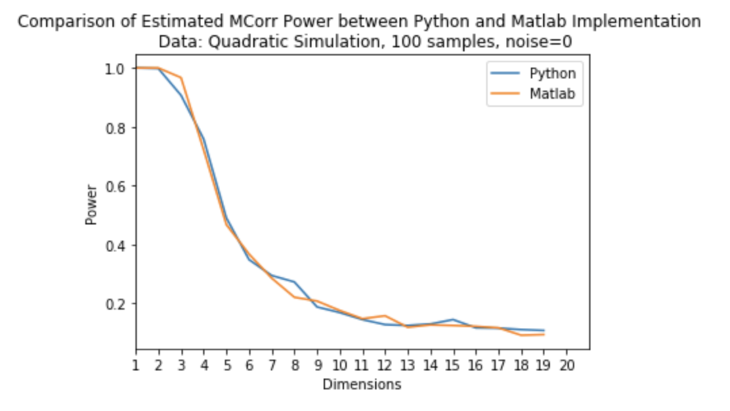
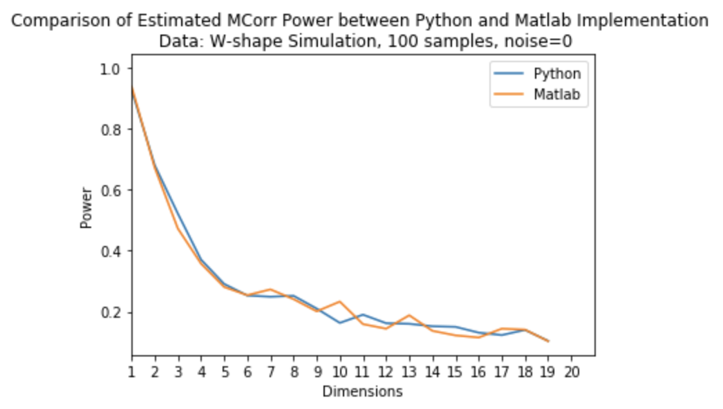
Power
(code & test)

Slide 17
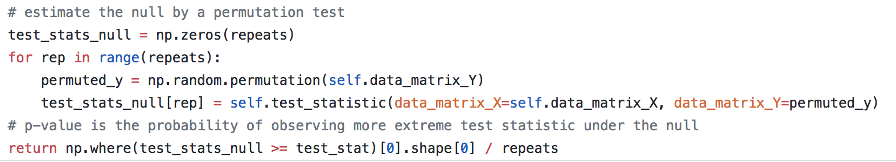
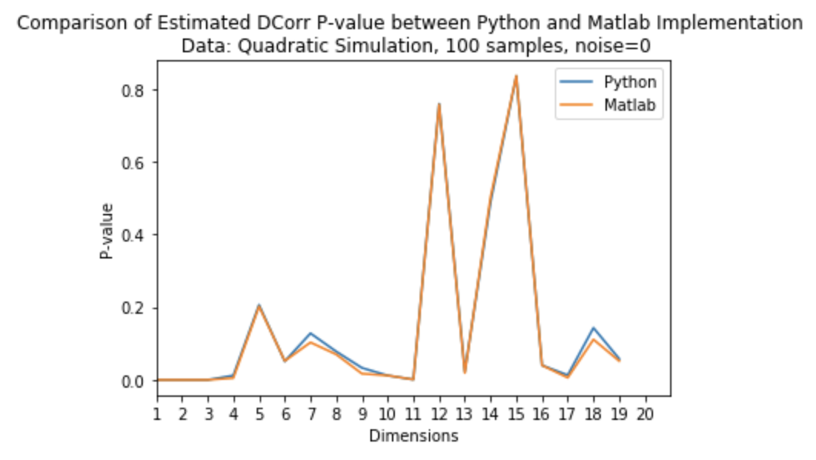
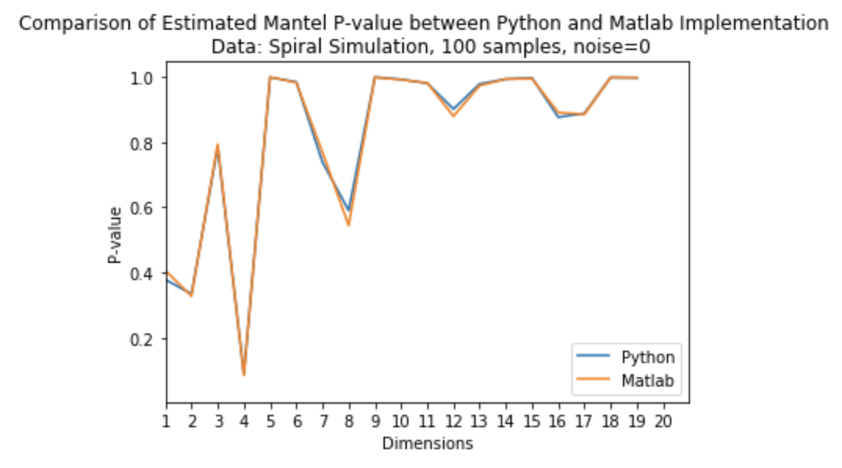
Permutation test for dcorr/mantel p-value
(python code, matlab code, test)

Slide 18
Next Week
Complete testing for the dcorr module, merge code & unit tests into development branch
DoD: Merged PR
Start graph independence test?
DoD: Discuss w/ jovo

Slide 19
Task 5 (Richard): Random Forest Independence Test
Last Week’s Accomplishments:
Clean up jupyter notebooks to show initial results of algorithm
DoD: Link to very clean jupyter notebook
Showing convergence of random forest estimator in simple case (LINK)

Slide 20
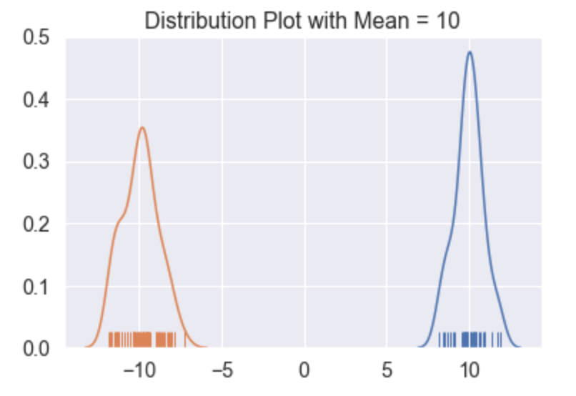
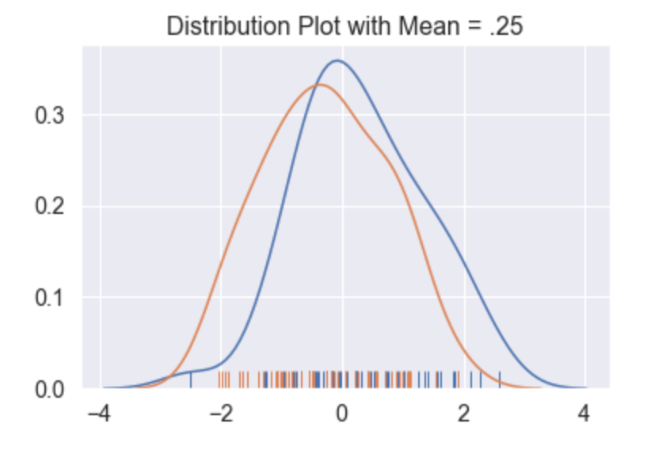
Does our random forest estimate converge to the true conditional entropy?
Experiment Setup:
Let Y ~ Bernoulli(½) (Y = -1 or 1)
Let X ~ Normal( y*mu, 1)
We want to ask these two questions. Given n (X_i, Y_i) samples:
Does our estimate converge to true H(Y|X) as n -> \infty?
Does our estimate converge to 0 as mu -> \infty?

Slide 21
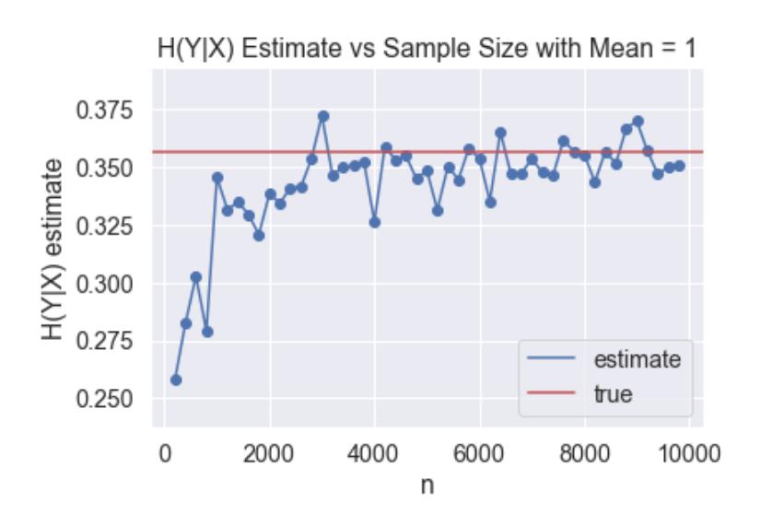
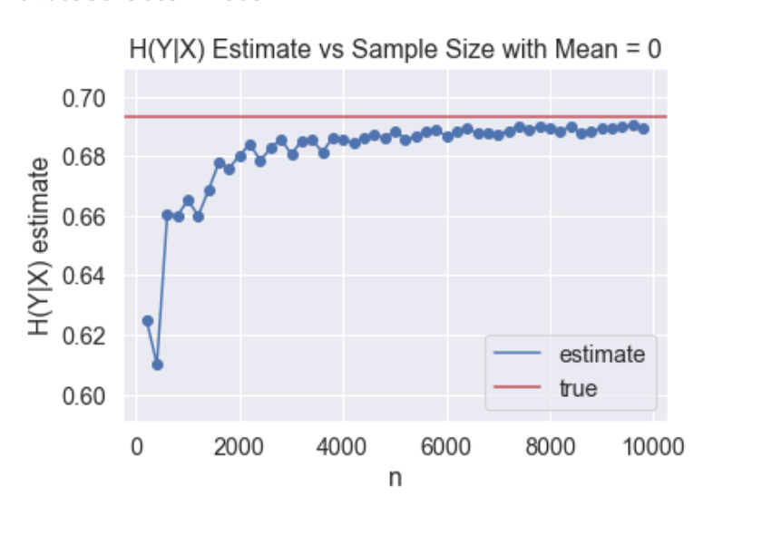
Does our estimate converge to true H(Y|X) as n -> infinity?
Notes:
@richard: encourage people to look at notebook for all the maths

Slide 22
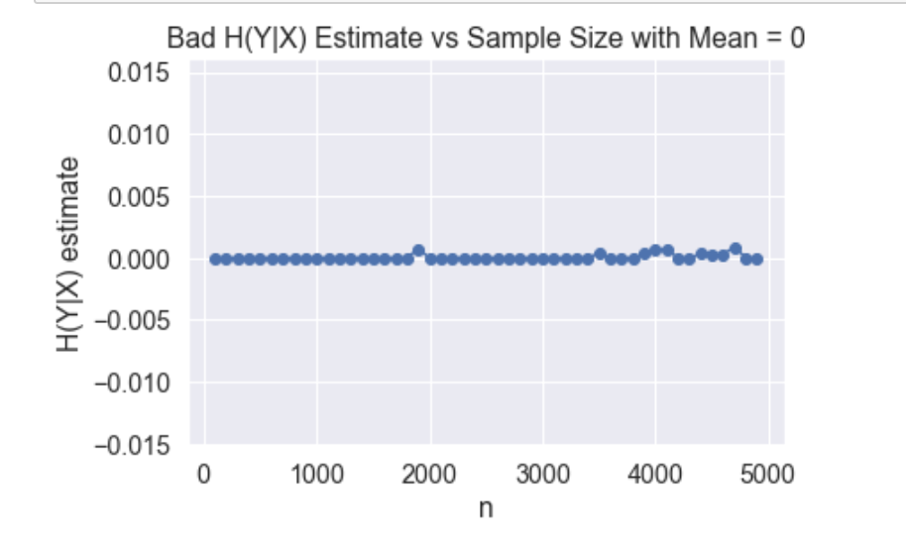
When our trees overfit, bad things happen!
Notes:
@richard: each tree had a depth of over 25! Had to limit depth in order to produce results above (max_depth = 4)
Also, don’t know y this didn’t affect previous test data (see cleaned up notebook). There, without setting max_depth, trees only reached max_depth of 3 (even though variables were independent).

Slide 23
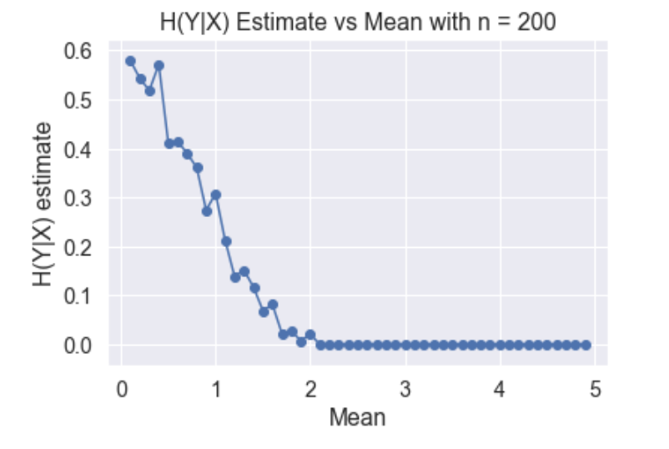
Does our estimate converge to 0 as mu -> infinity?

Slide 24
Next Week:
Talk to jovo about how to prevent random forest from overfitting
Talk to jovo about new interesting tests to run

Slide 25
Task 6 (Ananya): Implement 2-sample tests into package
Normalize kernel matrix
DoD: Verify equality between ENERGY and MMD holds after normalization
Run ENERGY in R
DoD: Make sure R-ENERGY and P-ENERGY output the same test statistic
Run MMD in R
DoD: Make sure R-MMD and P-MMD output the same test statistic

Slide 26
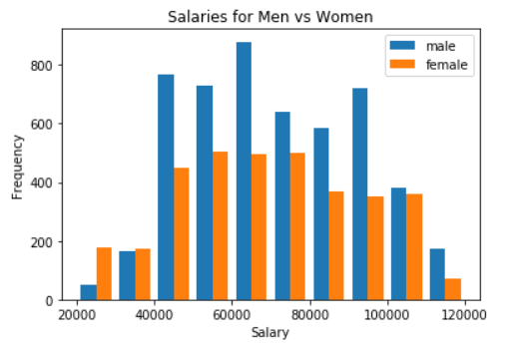
Looking at the data
Employee salaries in Montgomery, MD (2017)
(https://catalog.data.gov/dataset/employee-salaries-2017)
Code for histogram here

Slide 27
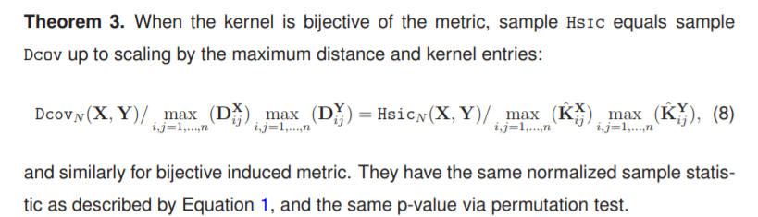
Kernel matrix must be normalized before using MMD
Use k(xi,xj) = 1 - d(xi,xj)/(max d(xi,xj)) to get kernel matrix from distance matrix

Slide 28
ENERGY and MMD output the same test statistic after normalization (yay)
Code for ENERGY here
Test statistic: 0.000163
Code for MMD here
Test statistic: 0.000163

Slide 29
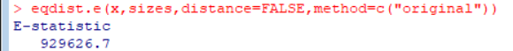
R-ENERGY and P-ENERGY do not output the same test statistic
Code for R-ENERGY here

